Slide 1
DIMENSIONING
Dimensioning refers to the act of giving dimensions.
Dimension is a numerical value expressed in appropriate units of measurement and indicated graphically on technical drawings with lines, symbols and notes to define the size, shape, location, geometric characteristic, or surface texture of a feature.
Each part has dimension such as length, width, height, radius etc.

Slide 2
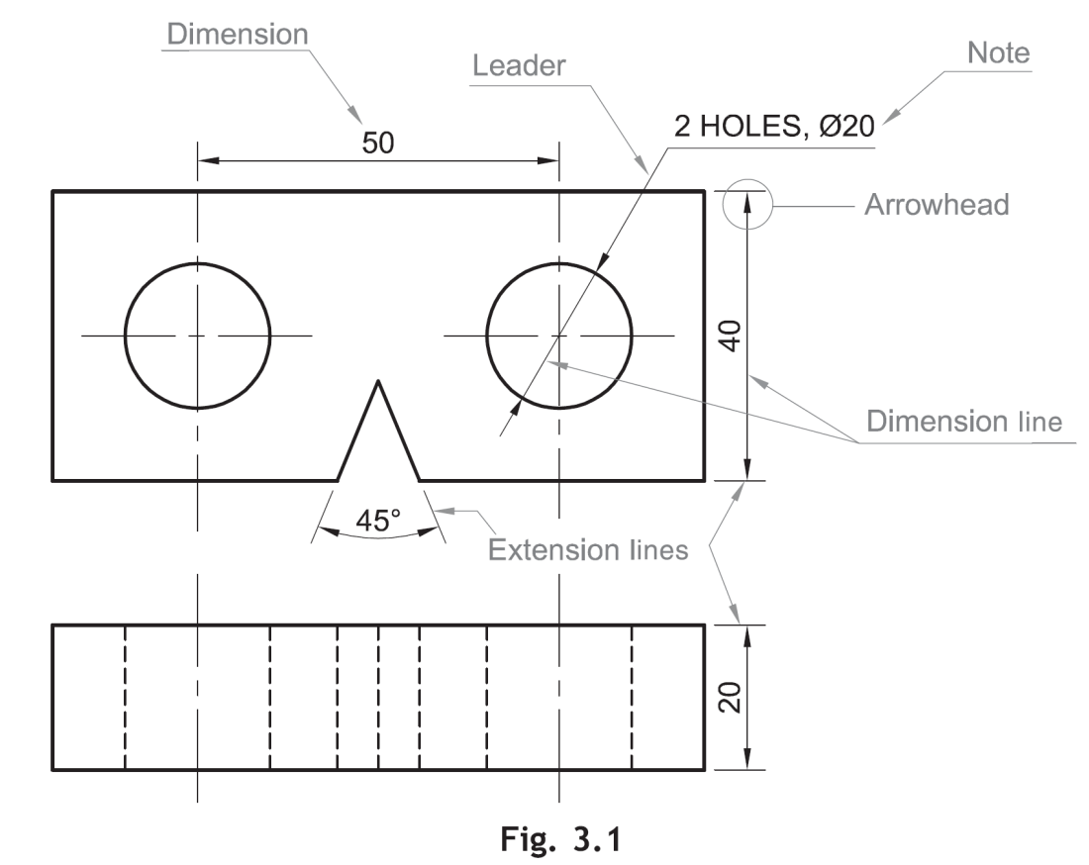
ELEMENTS OF DIMENSIONING
A line on the drawing whose length is to be shown is called an object line.
Dimensioning is often done by a set of elements, which includes extension lines, dimension lines, leader lines, arrowheads and dimensions. These are shown in Fig. 3.1.
z

Slide 3
Dimensioning Terms & Notations:-
1. Dimension Line:-
A dimension line, with its arrowheads, shows the direction & extent of a dimension.
2. Extension Line:-
These lines extend from points, lines or surfaces to enable the dimensions to be placed outside the outline, wherever possible, to indicate the extent of a measurement given by dimension line.
3. Dimension:-
It is the Numerical Value, expressed in appropriate units of measurement and indicated above dimension lines.
4. Termination & Origin Indication:-
Dimension lines should show distinct termination, i.e., either arrowheads, or oblique strokes, or where applicable, an origin indication.

Slide 4
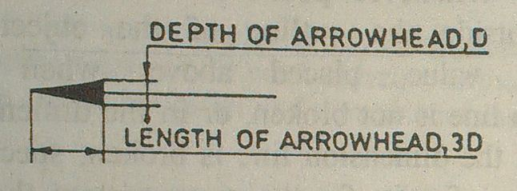
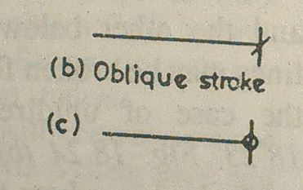
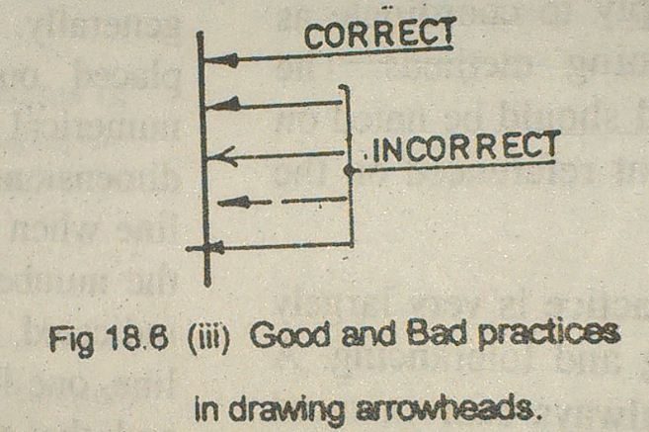

Slide 5
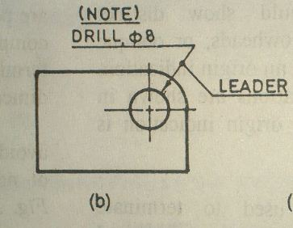
5. Arrowheads:-
6. Leaders:-

Slide 6
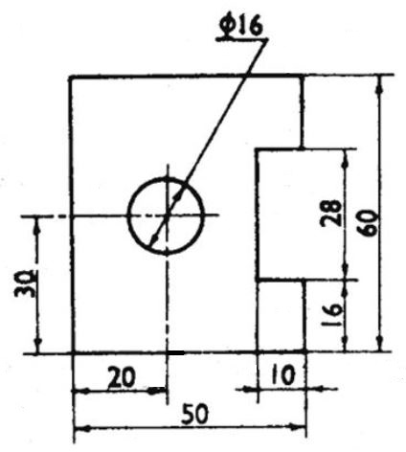
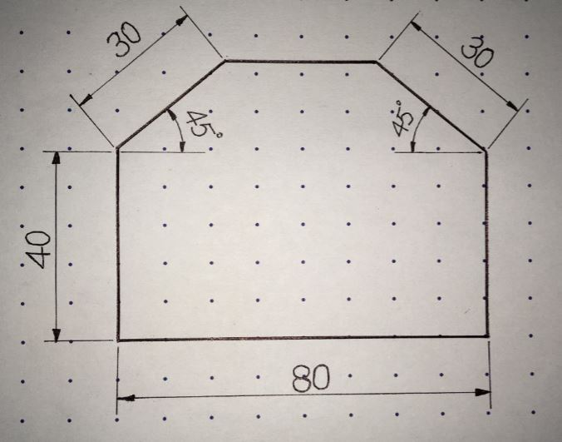
SYSTEMS OF DIMENSIONING
Aligned System
In the aligned system, dimensions are placed perpendicular to the dimension line so that they may be read from the bottom or right-hand side of the drawing sheet. Dimensions are placed at the middle and on top of the dimension lines.
Example 1
Example 2

Slide 7
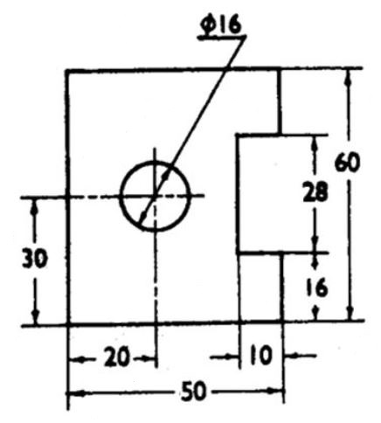
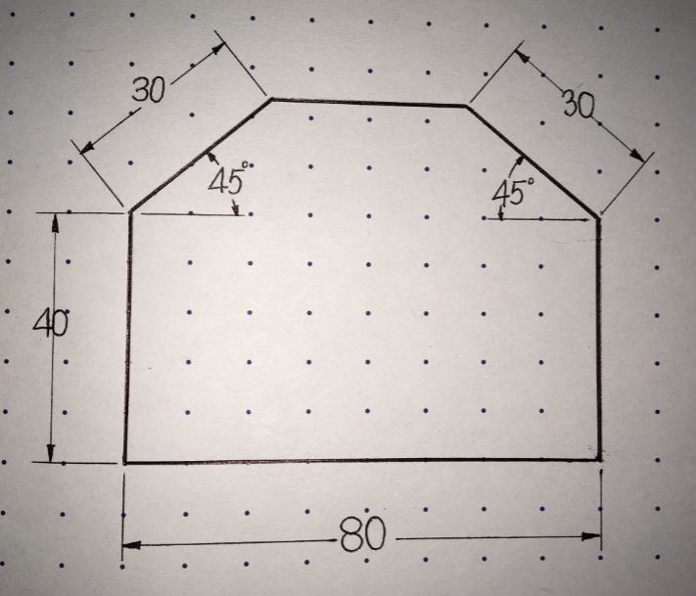
Unidirectional System
In the unidirectional system, dimensions are placed in such a way that they can be read from the bottom edge of the drawing sheet. As shown in Fig. 3.5, all dimensions are placed at the middle and are inserted by breaking the dimension lines at the middle.
Example 1
Example 2

Slide 8
RULES OF DIMENSIONING
Between any two extension lines, there must be one and only one dimension line bearing one dimension.
As far as possible, all the dimensions should be placed outside the views. Inside dimensions are preferred only if they are clearer and more easily readable.
All the dimensions on a drawing must be shown using either Aligned System or Unidirectional System. In no case should, the two systems be mixed on the same drawing.
The same unit of length should be used for all the dimensions on a drawing. The unit should not be written after each dimension, but a note mentioning the unit should be placed below the drawing.
Dimension lines should not cross each other. Dimension lines should also not cross any other lines of the object.
All dimensions must be given.
Each dimension should be given only once. No dimension should be redundant.

Slide 9
Do not use an outline or a centre line as a dimension line. A centreline may be extended to serve as an extension line.
Avoid dimensioning hidden lines.
For dimensions in series, adopt any one of the following ways.
  Chain dimensioning (Continuous dimensioning) All the dimensions are aligned in such a way that an arrowhead of one dimension touches tip-to-tip the arrowhead of the adjacent dimension. The overall dimension is placed outside the other smaller dimensions, Fig. 3.13(a).
  Parallel dimensioning (Progressive dimensioning) All the dimensions are shown from a common reference line. Obviously, all these dimensions share a common extension line. This method is adopted when dimensions have to be established from a particular datum surface, Fig. 3.13(b).
  Combined dimensioning When both the methods, i.e., chain dimensioning and parallel dimensioning are used on the same drawing, the method of dimensioning is called combined dimensioning, Fig. 3.13(c).

Slide 10
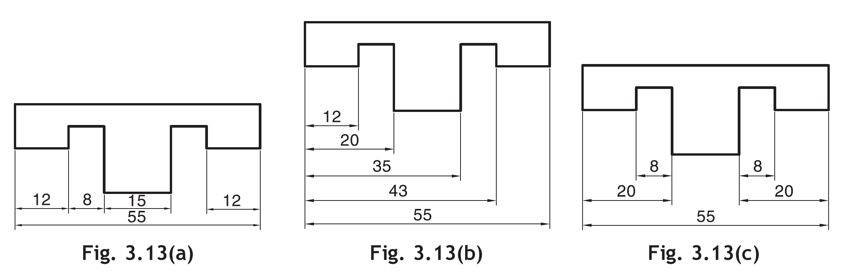
Smaller dimensions should always be placed nearer the view. The next smaller dimension should be placed next and so on.
All notes should be written horizontally.

Slide 11
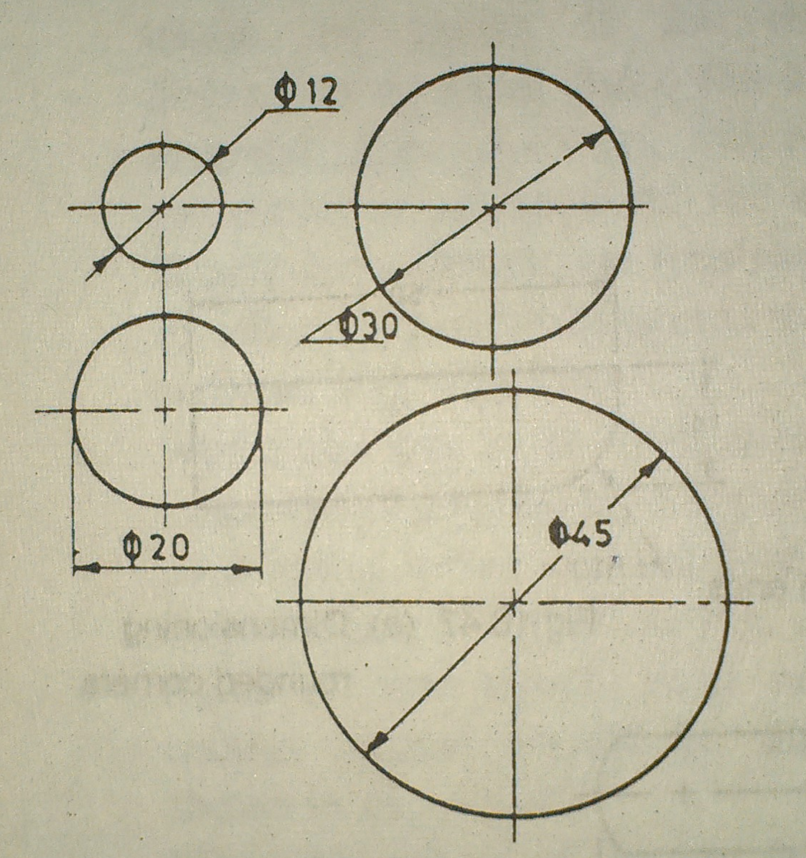
Dimensioning of Circular Features
A circle should be dimensioned by giving its diameter instead of radius. The dimension indicating a diameter should always be preceded by the symbol ø,

Slide 12
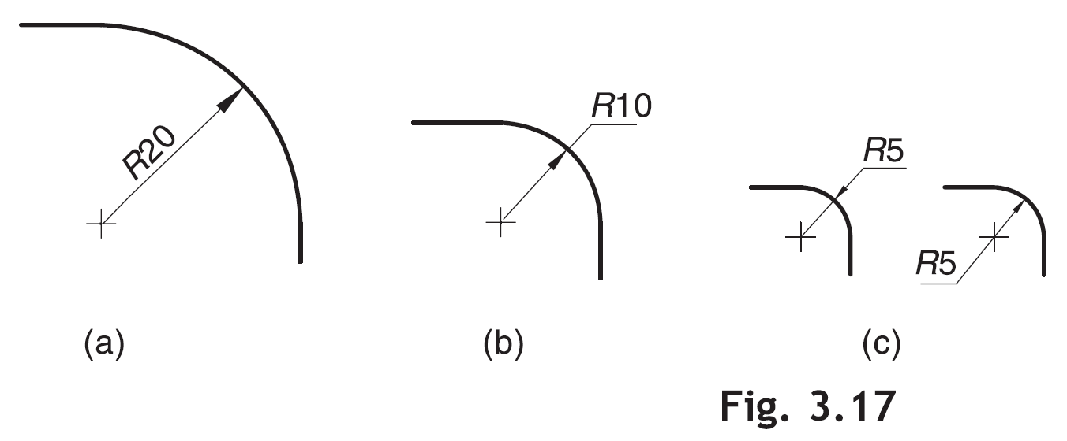
An arc should be dimensioned by giving its radius. The dimension indicating radius should be preceded by symbol R, Fig. 3.17.

Slide 13
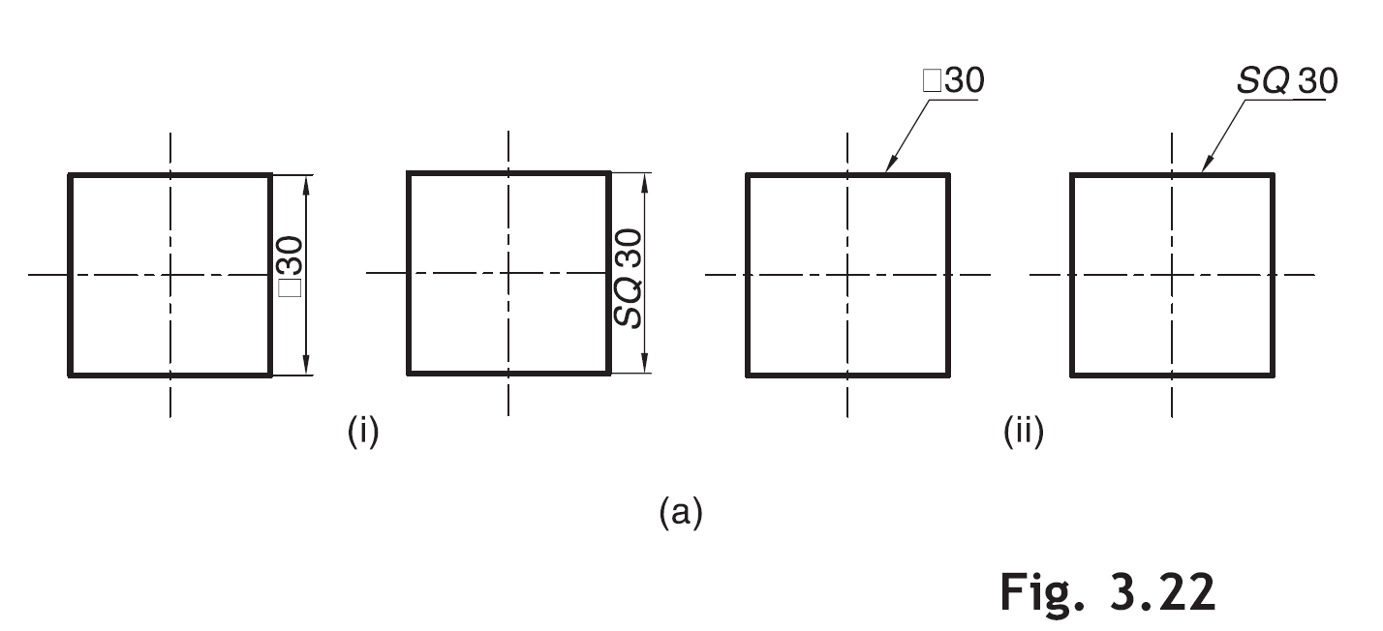
Dimensioning of Square Features
Square features (e.g., a rod of square cross-section) are dimensioned using symbol or SQ as shown in (i) or (ii), Fig. 3.22(a).

Slide 14
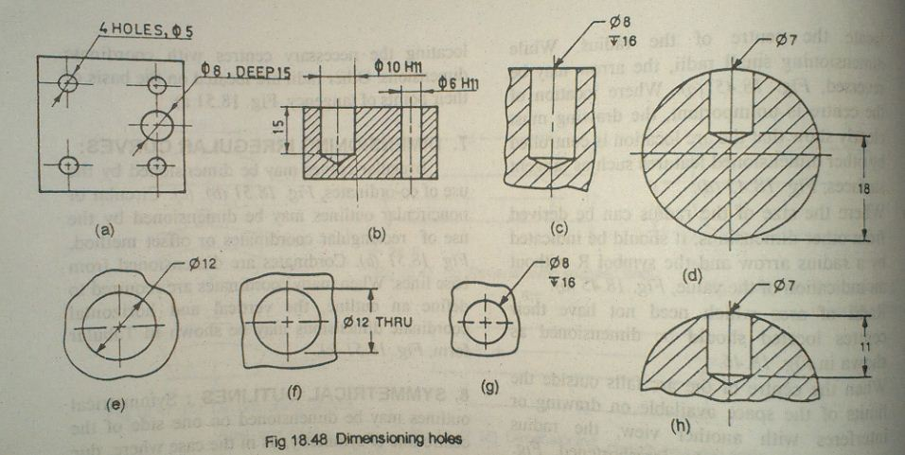
Dimensioning of Holes:-

Slide 15
Theory of Dimensioning:-
Dimensioning should be undertaken with a view to carefully defining the shape or form and overall size of the component and also the sizes and positions of the various features from the necessary datum planes or axes.
A drawing usually requires two types of dimensions:-
Size dimensions
Location Dimensions

Slide 16
